Slide 1

SALES PREDICTION ACROSS MULTIPLE STORES
BY MANILA DUGAR

Slide 2
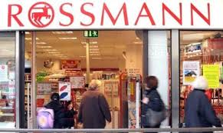
Exploration of customer purchasing behaviour

Slide 3
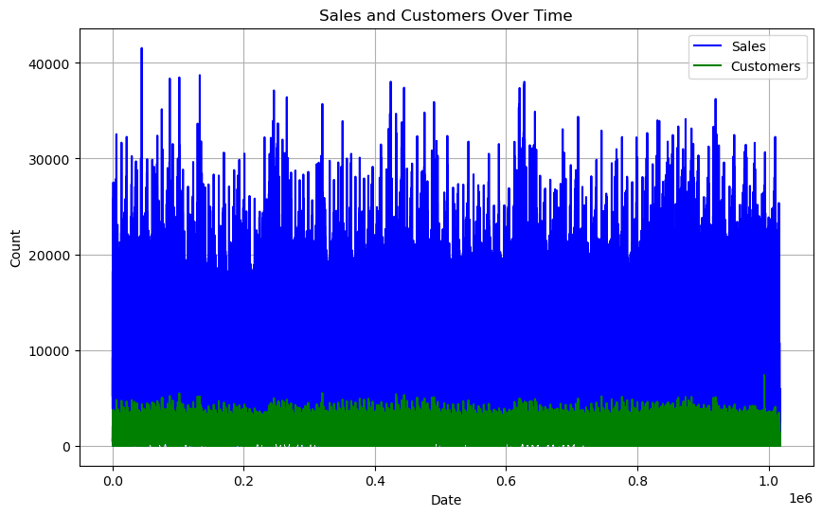
The sales is directly related to customer

Slide 4
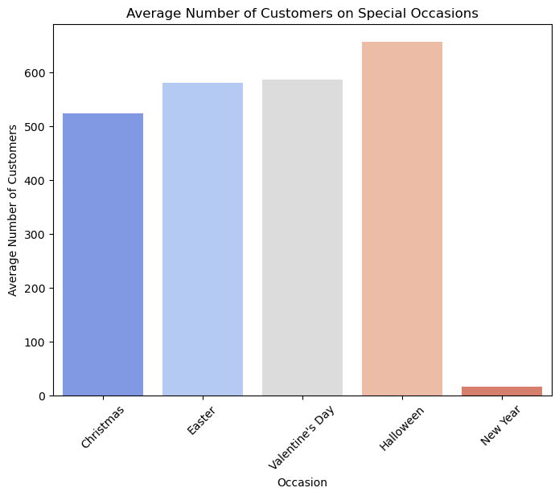
Unveiling Seasonal Sales Trends in Pharmaceutical Stores
In this presentation, we delve into the intriguing correlation between Halloween, the beginning of winter, and its impact on pharmaceutical store sales. Halloween drives consumer behavior, leading to increased spending and social gatherings .
As Halloween arrives, it signals the onset of the winter season with colder weather and climatic changes .
This transition has notable health implications, making individuals more susceptible to illnesses like colds, flu, and seasonal affective disorder.
Consequently, pharmaceutical store sales surge, as consumers seek health-related products.
To capitalize on this surge, pharmaceutical stores can employ seasonal marketing strategies while also addressing specific health needs during winter.
In conclusion, recognizing and catering to this seasonal sales phenomenon is key for pharmaceutical stores.

Slide 5
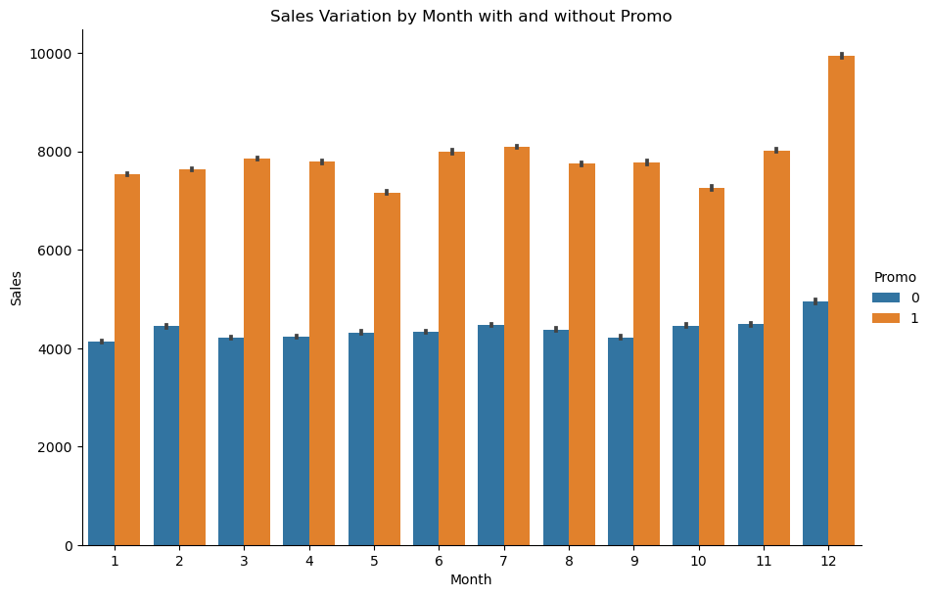
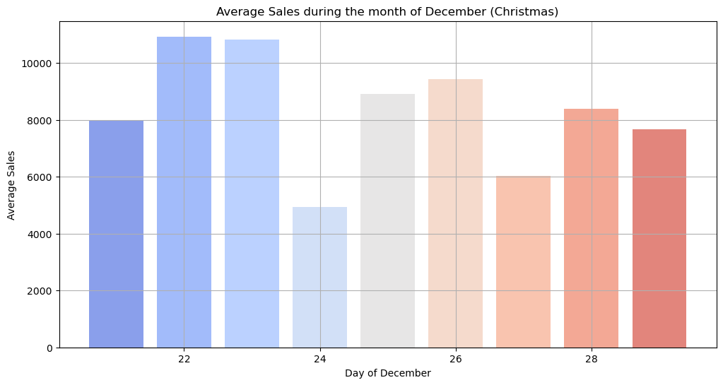
Promotions play a pivotal role in driving sales in pharmaceutical stores, with December emerging as a strategic hotspot for these marketing endeavors.
Notably, the period from December 22nd to 25th, encompassing the Christmas holiday, witnesses a surge in promotional activities.
This timing aligns with the transition from winter to spring, a critical juncture when consumers seek health-related products.
Pharmacies strategically capitalize on this consumer behavior by offering discounts, special deals, and targeted promotions during this festive season.
Recognizing the correlation between seasonal transitions, heightened health concerns, and promotions is crucial for pharmaceutical stores to maximize their sales potential.

Slide 6
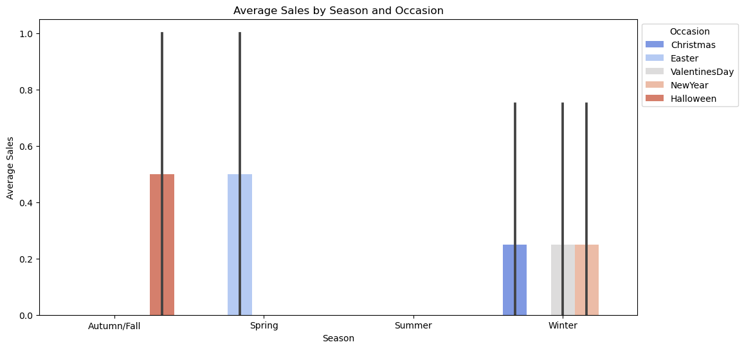

Slide 7
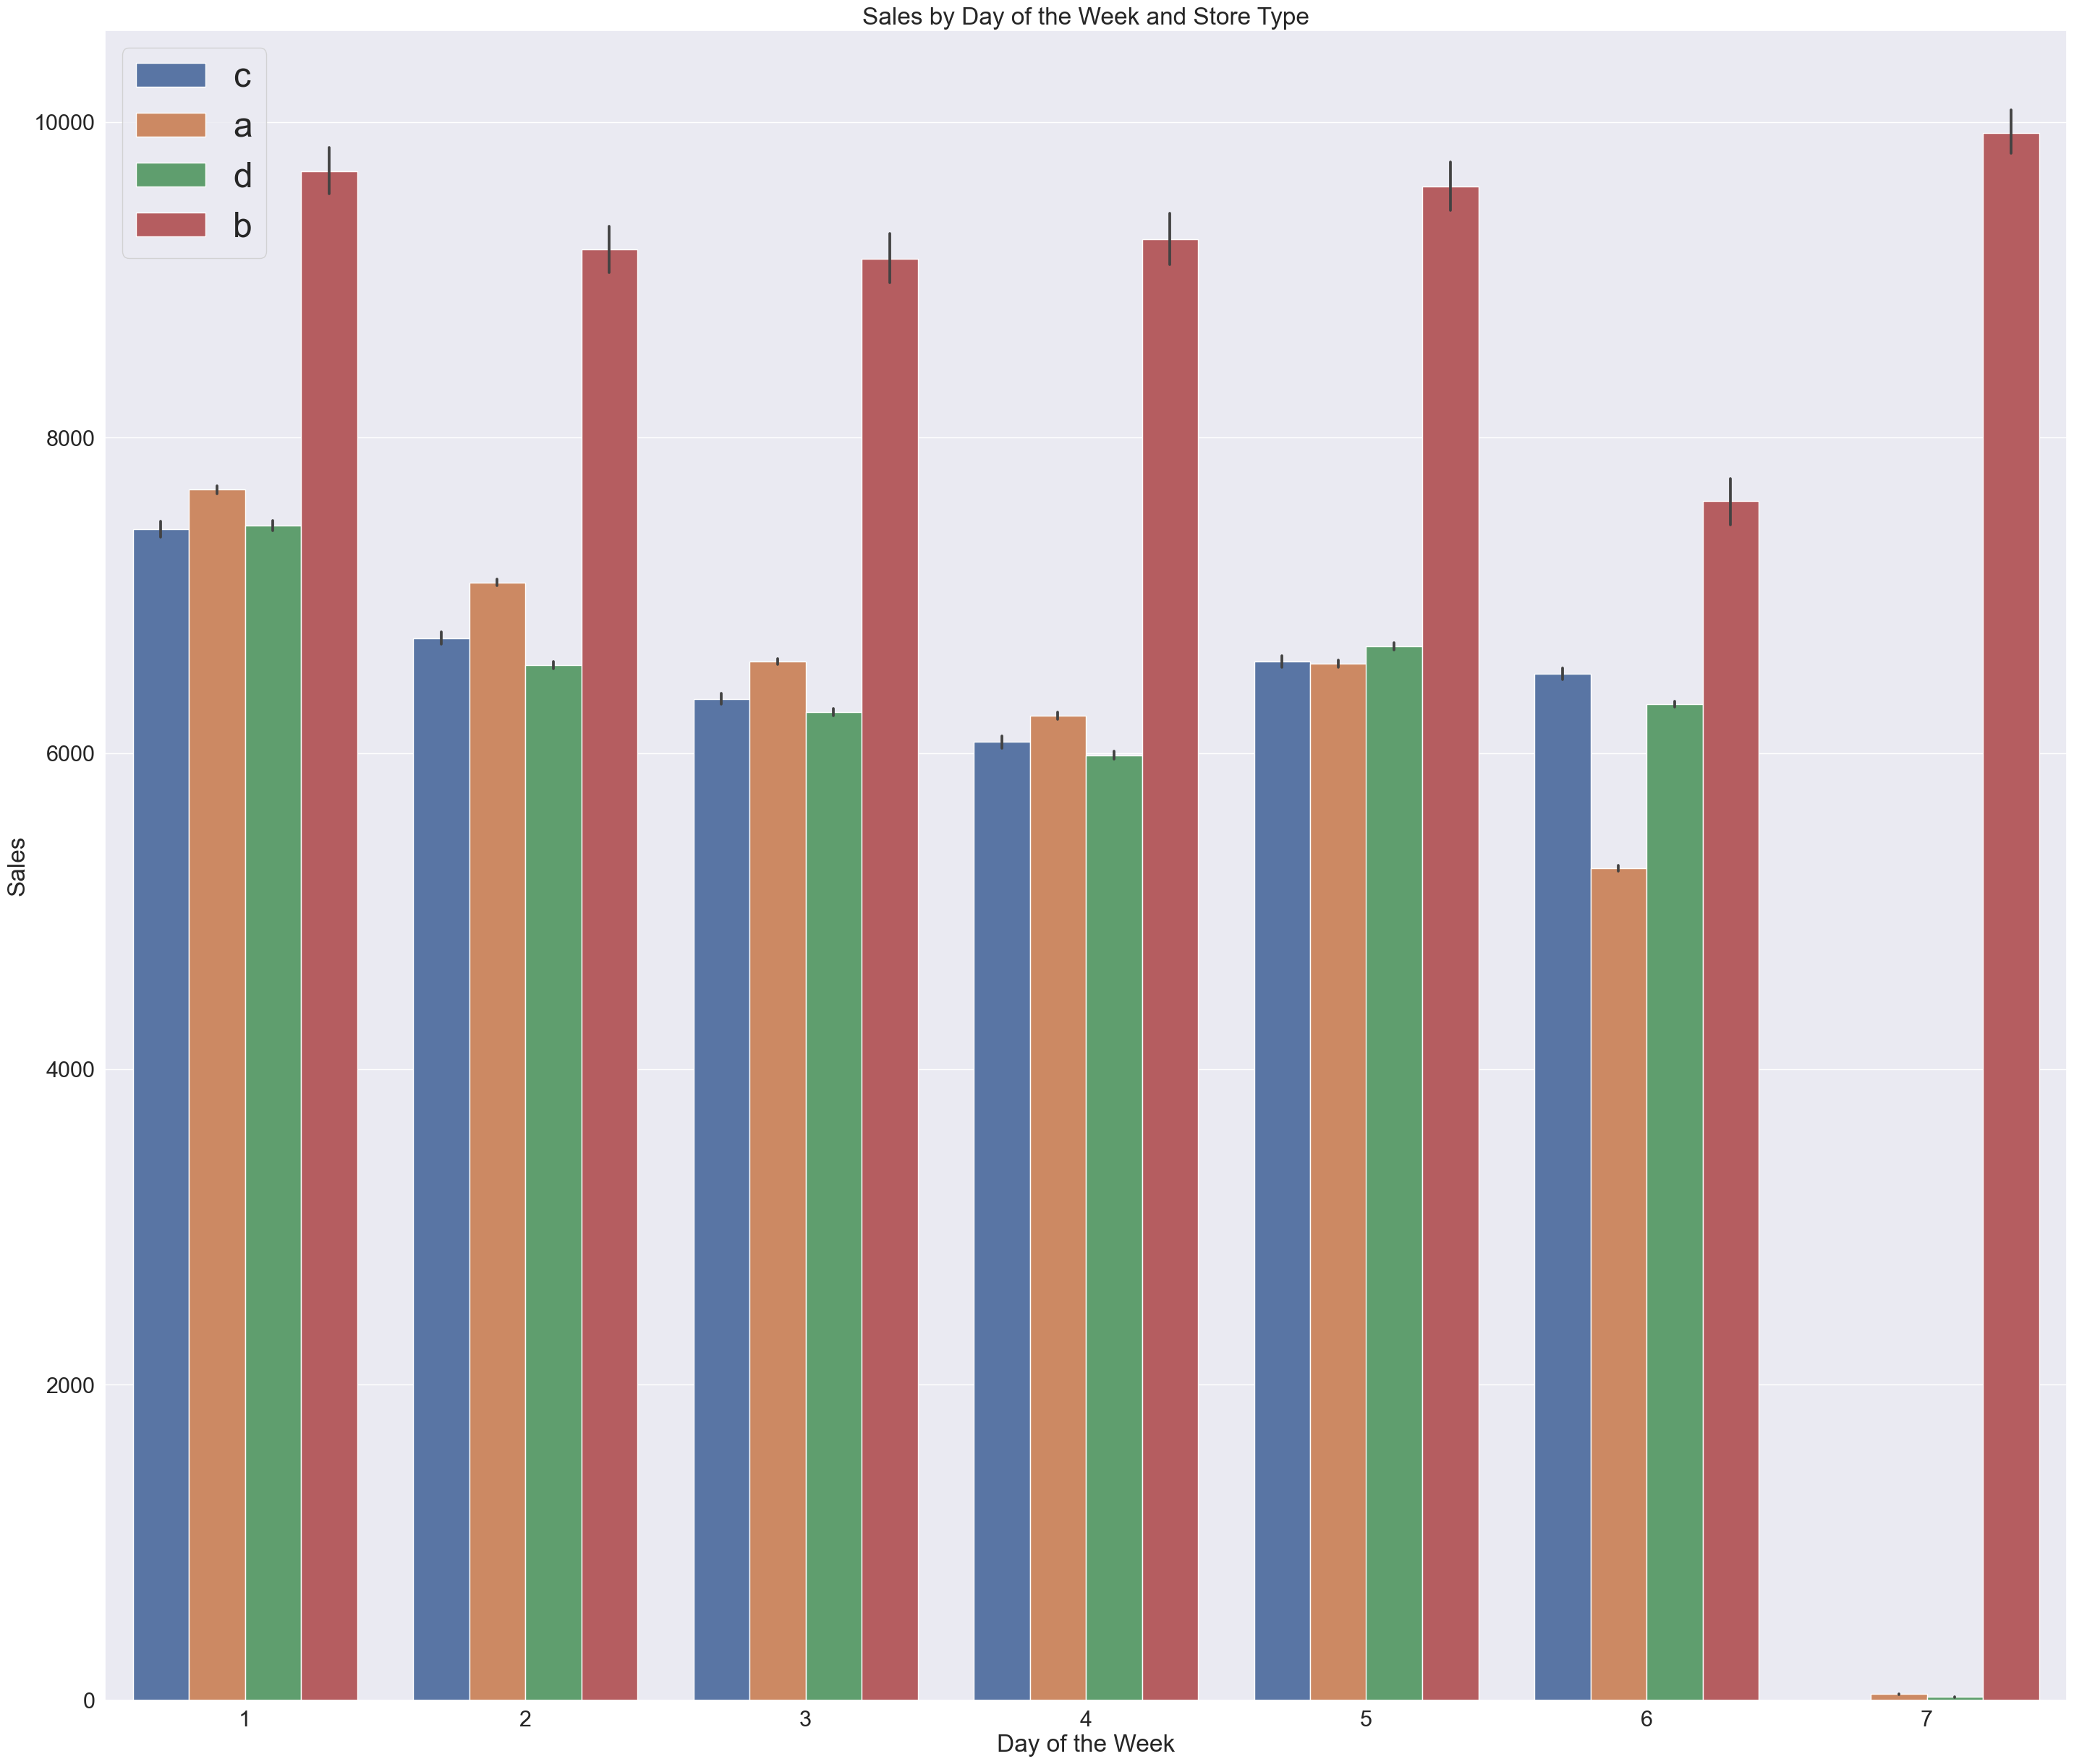
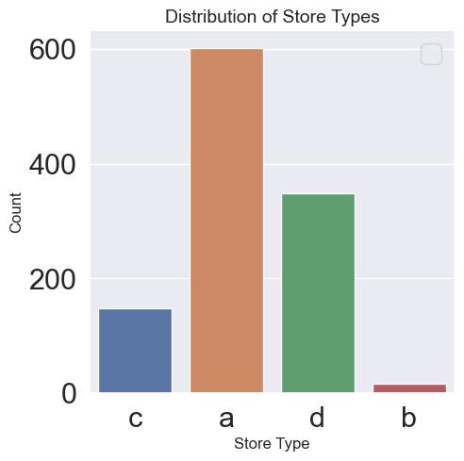
There are four store types: A, B, C, and D.
Store A has more locations, but store B has higher weekly sales.

Slide 8
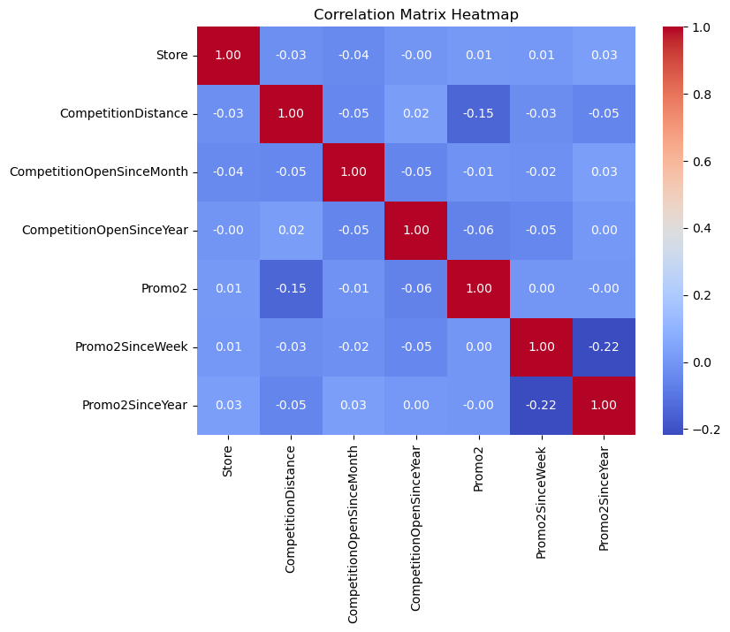

Slide 9
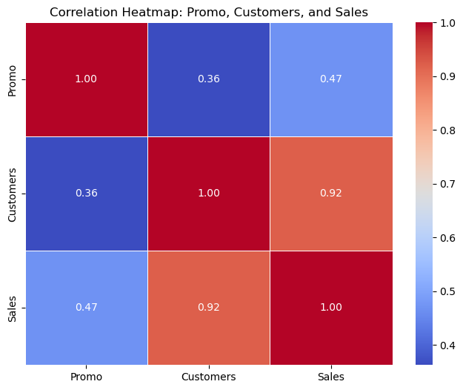
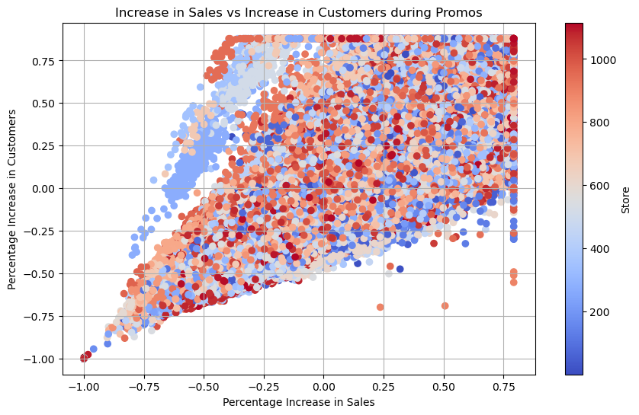
There is a very strong correlation between sales and customers; an increase in customers leads to an increase in sales accurately describes a fundamental principle of business.
It highlights the positive relationship between the number of customers a business serves and its overall sales.
When more customers visit or engage with a business, it often results in higher sales revenue.
This concept underscores the importance of attracting and retaining customers as a key driver of business growth and success.

Slide 10
Prediction Of Store Sales

Slide 11
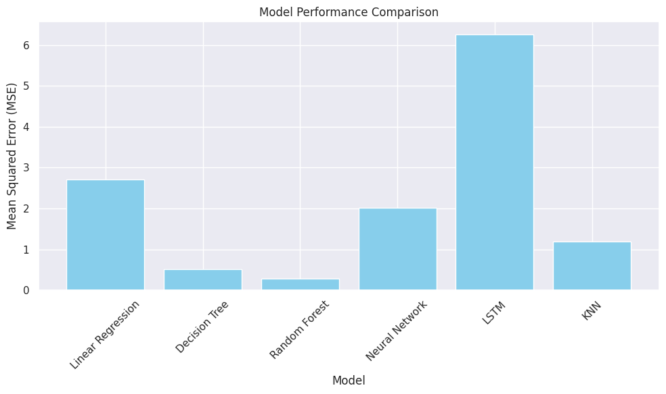
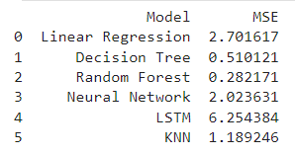
Models

Slide 12
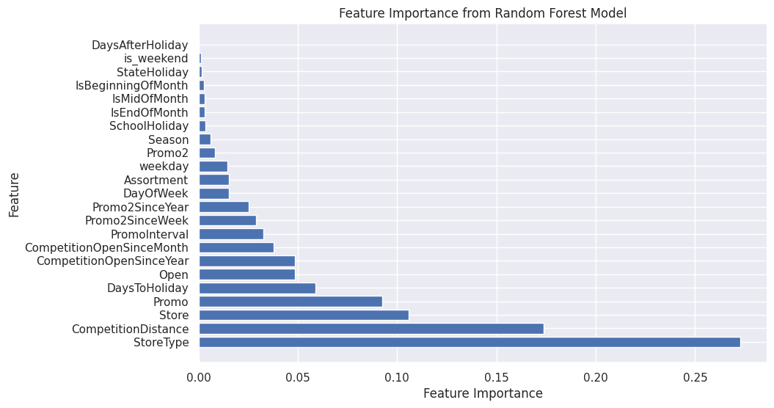

Slide 13
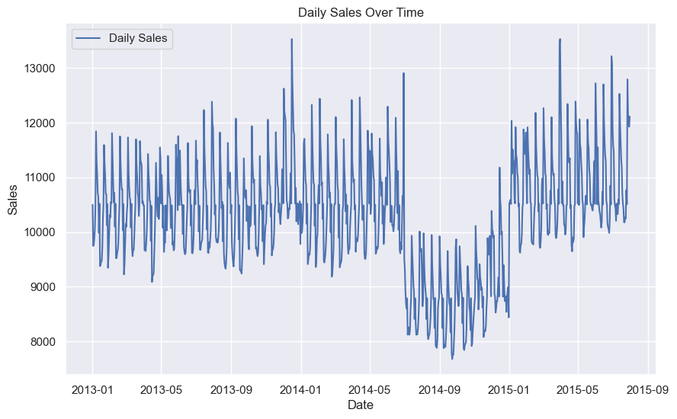
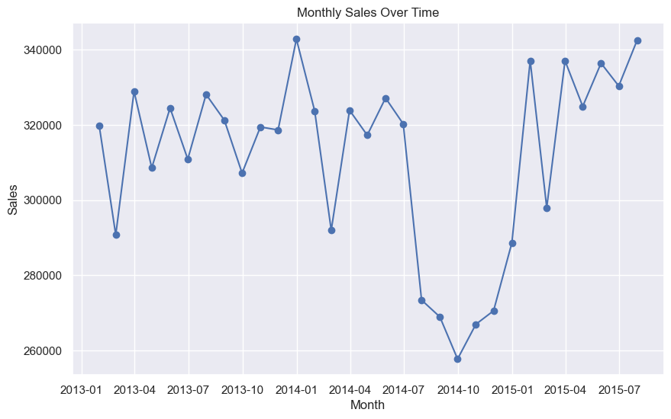
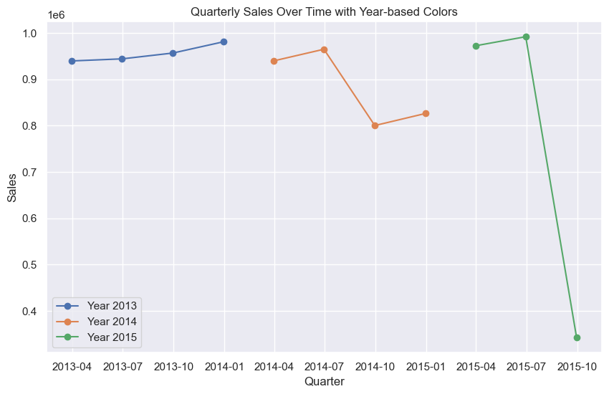
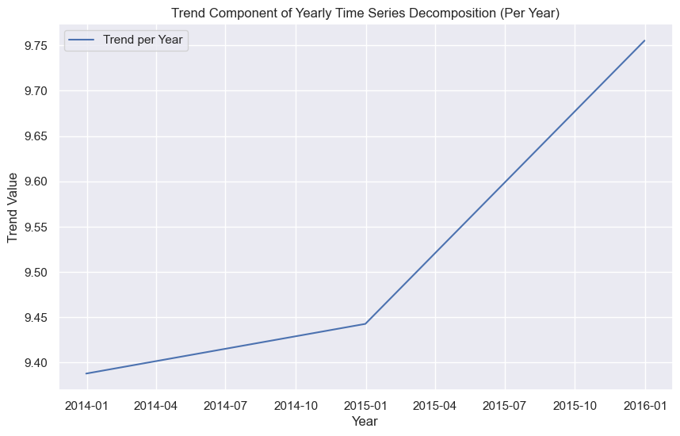
Trend Analysis

Slide 14
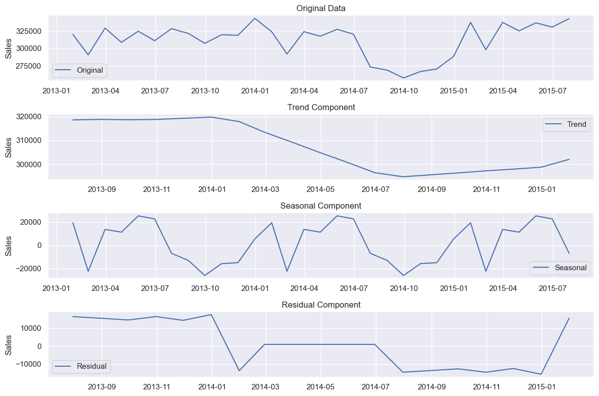

Slide 15
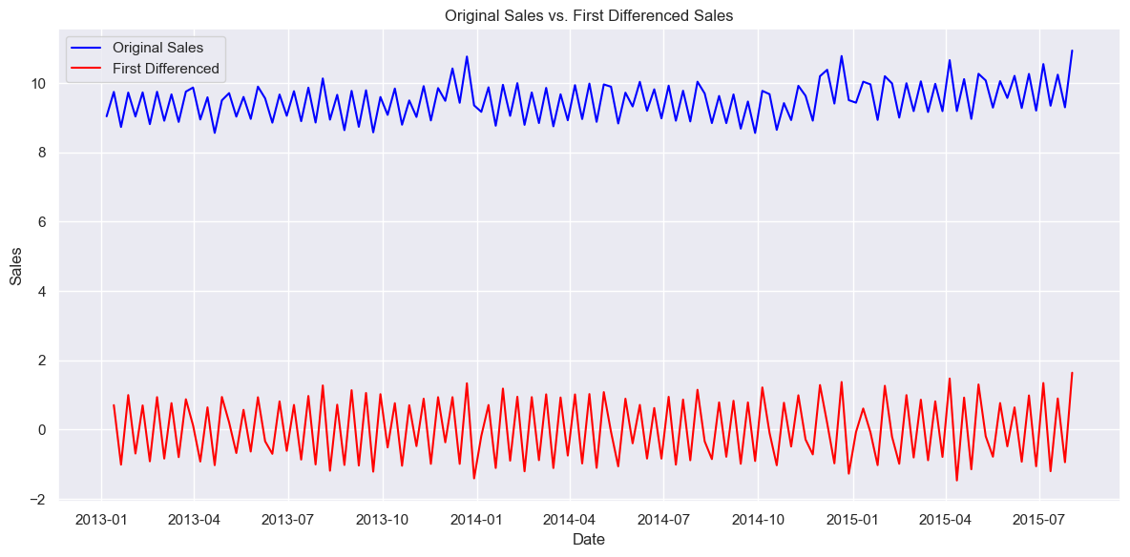
First Differenced Sales represents the sales data after applying a differencing operation, specifically taking the difference between each data point and the previous one.
The differencing process have reduced the overall variability or patterns in the data, making it appear more stable or stationary.

Slide 16
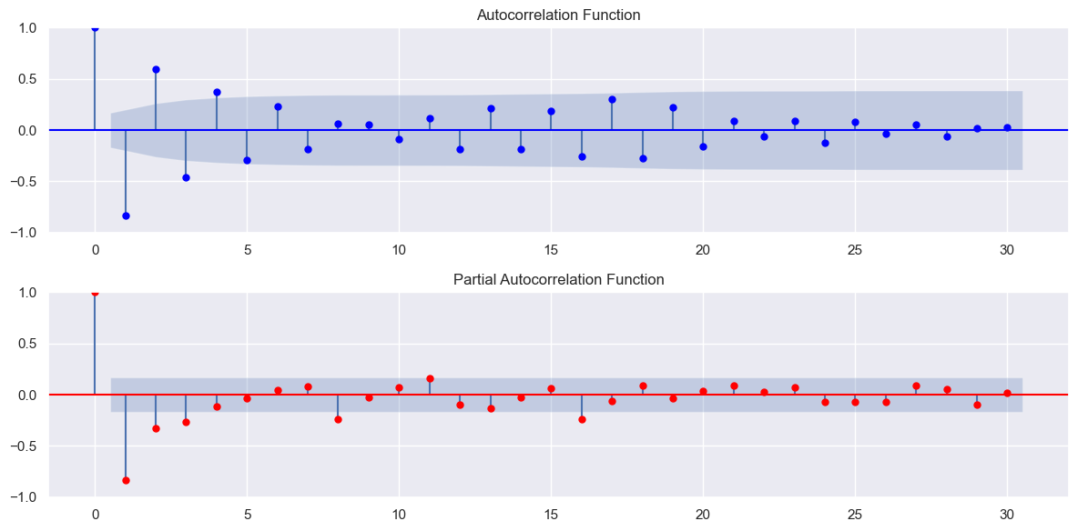
A fluctuating ACF pattern with both falling and rising values typically signifies seasonality within the data. It suggests regular, repeating cycles at specific time intervals.
On the other hand, when PACF values are notably lower than ACF values, it indicates that the direct correlation between the current observation and its past lags is relatively weak compared to the influence of other lags or variables.

Slide 17
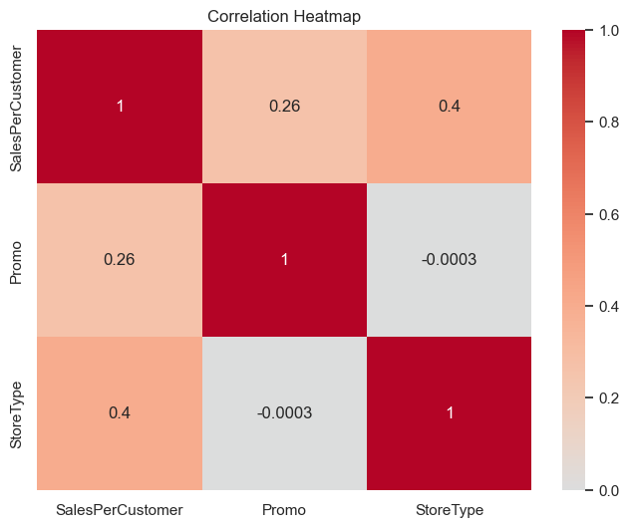

Slide 18
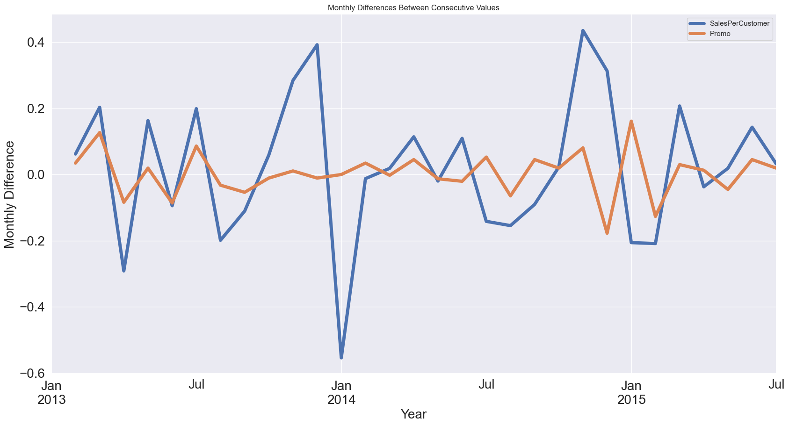
Regular promotions are conducted, but these promotional activities do not significantly increase the number of customers; however, they do lead to an increase in sales.

Slide 19
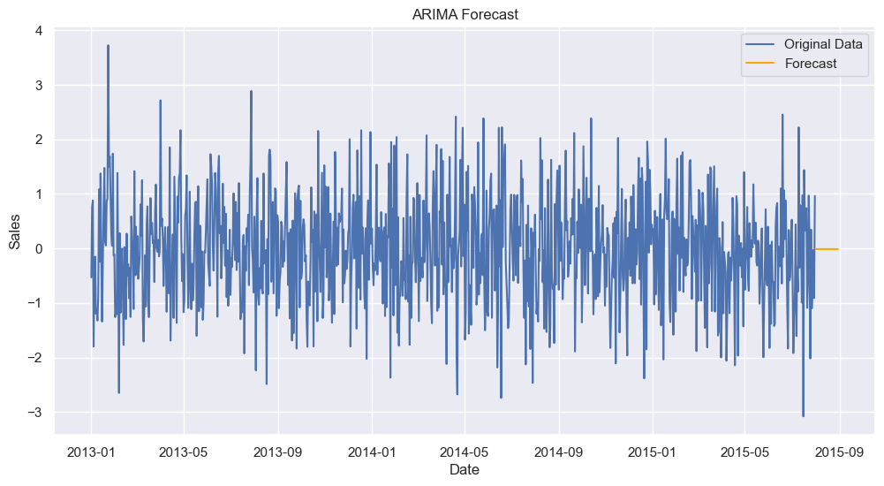
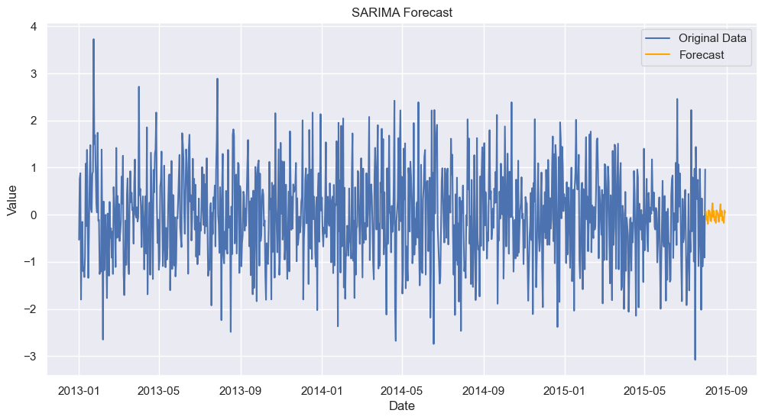
In this stepwise search for the best ARIMA model, various combinations were tested to minimize the AIC (Akaike Information Criterion), which is a measure of a model's goodness of fit. The presented models represent different combinations of autoregressive (AR), differencing (I), and moving average (MA) components, as well as seasonal components (S).
The best-fitting model identified is ARIMA(0,1,0)(1,1,0)[12], which suggests a non-seasonal differencing order of 1, no autoregressive or moving average components, and a seasonal differencing order of 1 with a seasonal component of 12 (indicating seasonality at a 12-month interval).
The results of this best-fitting model show that it has the lowest AIC value (408.305), indicating a good fit to the data. The coefficients and diagnostic statistics are also provided, offering insights into the model's performance and its ability to capture the underlying patterns in the time series data.

Slide 20
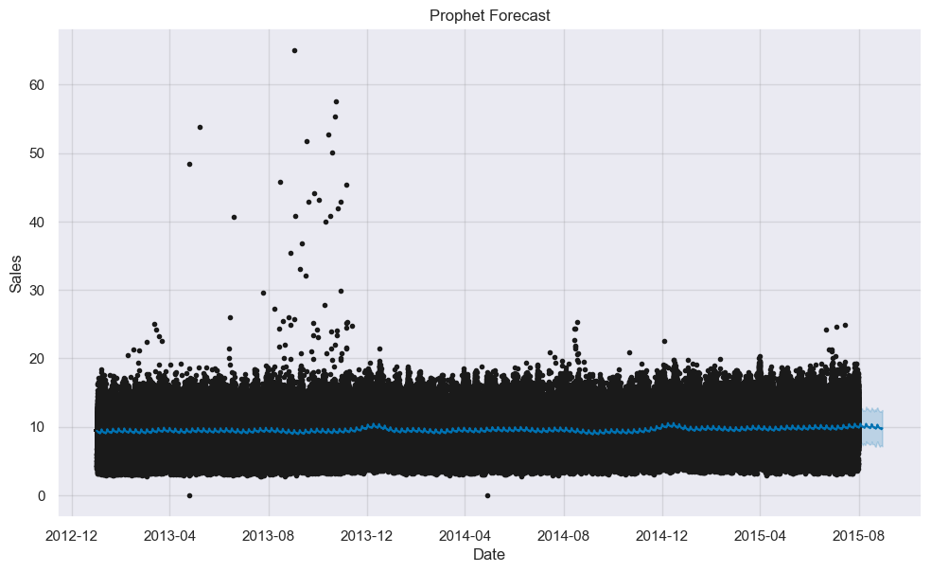

Slide 21
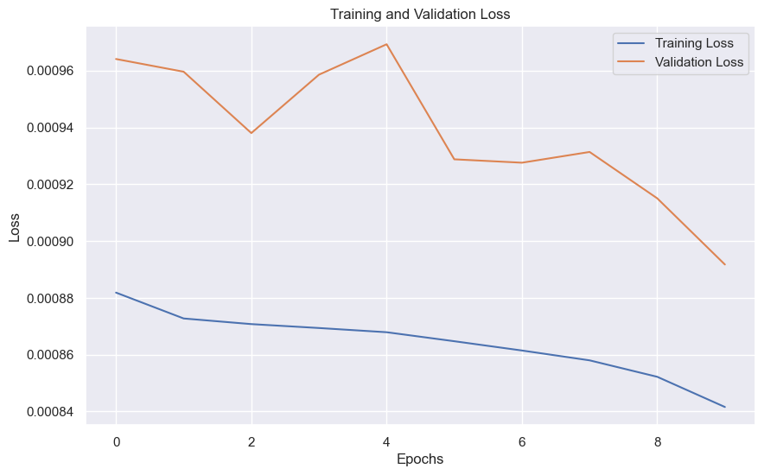
The training loss of 0.00088 and the validation loss of 0.00096, both sustained over 8 epochs, indicate a model that has achieved a high level of accuracy and generalization.
The training loss reflects how well the model is fitting the training data, and the validation loss gauges the model's performance on unseen data.

Slide 22
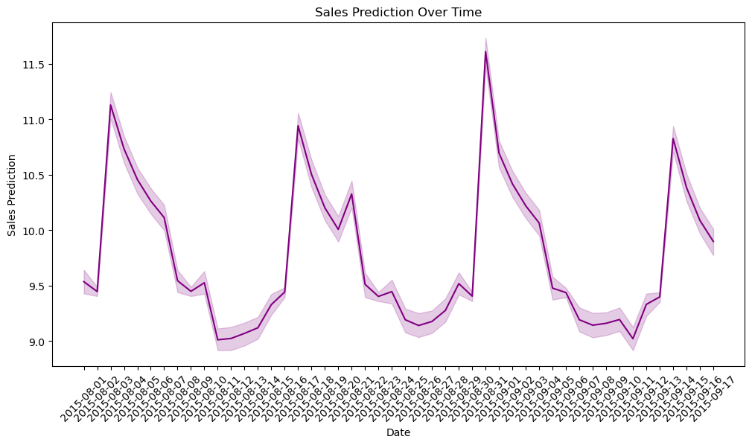
Sales Predicted for Test Data

Slide 23
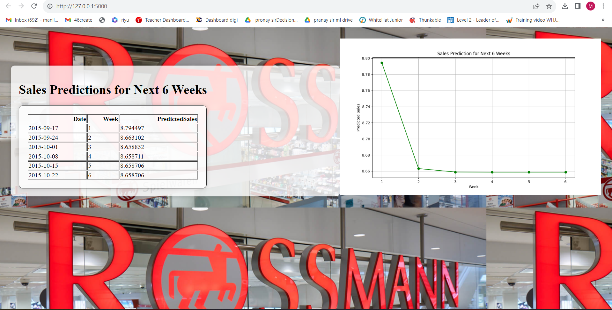
Sales Prediction for next 6 Weeks

Slide 24
Thank You

